Slide 1
Cyclistic Bike-Share Project
Marketing Strategies for converting casual riders into annual members.
Presented by: Huyun Li
Last Updated: September 3rd, 2024

Slide 2
TABLE OF CONTENTS
Purpose Statement (What are we talking about)
Data Source
Data Cleaning and Process
Tell the story (with data)
Conclusion
Appendix

Slide 3

PURPOSE STATEMENT
Cyclistic is a bike-share company, based in Chicago whose long-term goal is to maximize the number of annual memberships. To achieve the goal, the marketing team would like to design a new marketing strategy to convert casual riders into annual members. I am responsible for analyzing how casual riders and annual members use Cyclistic bikes differently, and designing marketing strategies based on results.
Analytics-driven / Decision-making / Data analytics / Marketing strategies

Slide 4
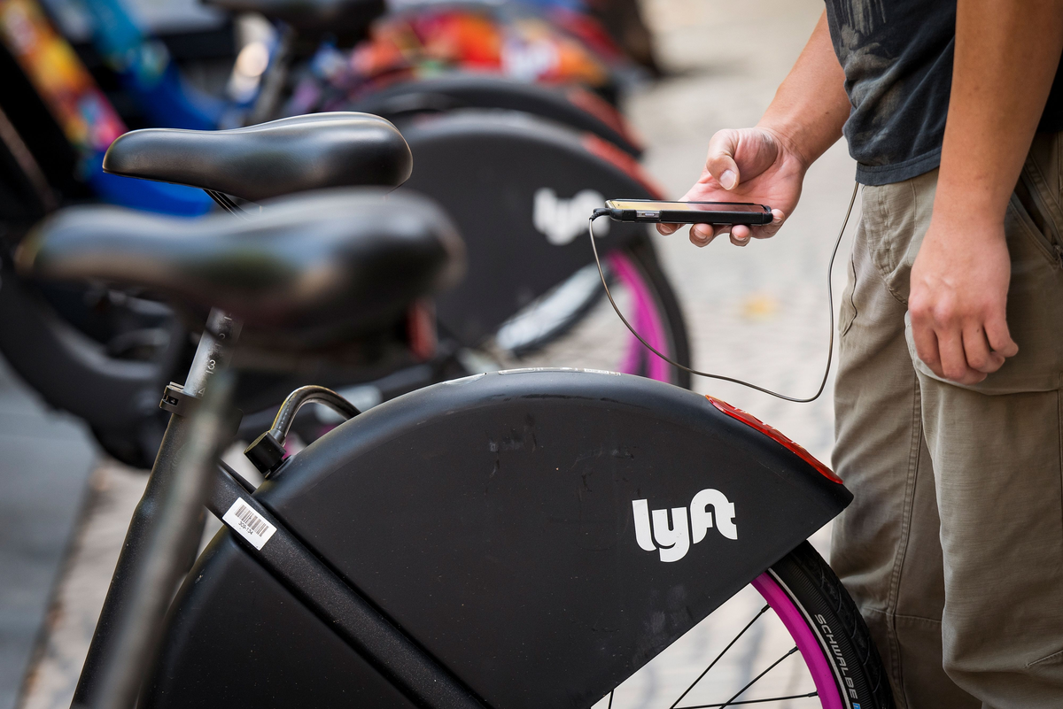
DATA SOURCE
The Data is organized by Lyft Bikes and Scooters, LLC (“Bikeshare”)
It is located in the Divvy system and is owned by the City of Chicago.
It is available for the public and free for use, subject to the terms and conditions of this License Agreement (“Agreement”).<https://divvybikes.com/data-license-agreement>
Latest Data: January 2024 to May 2024

Slide 5
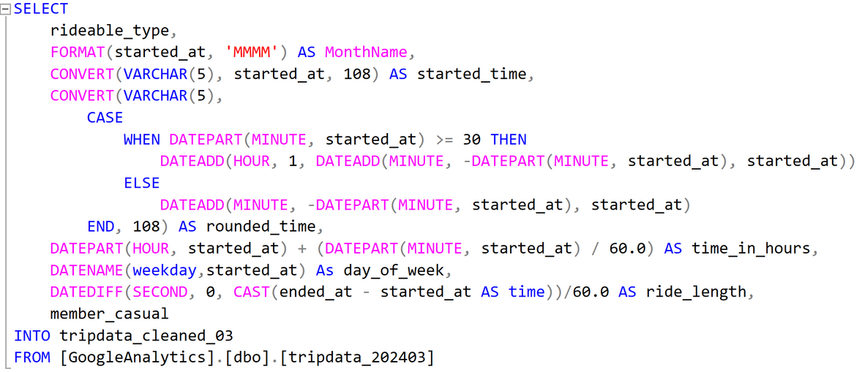
DATA CLEANING AND PROCESS
Tools: Microsoft SQL
Data Cleaning & Processing:
Convert Datetime value to character Month
Extract the time portion from Datetime value
Round the time values to the nearest hour
Convert the time part of a Datetime value to a numerical representation
Convert Datetime value to the day of the week
Create a new variable ‘length of ride’ by computing the difference between start time and end time
Union datasets from each month

Slide 6
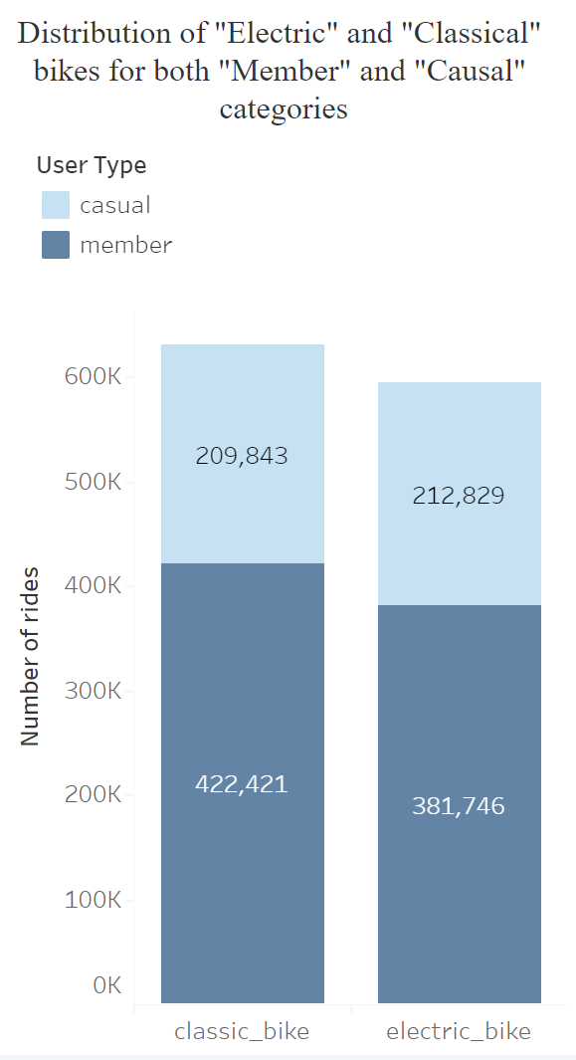
TELL THE STORY (WITH DATA)
Members prefer classic bikes over electric bikes
Casual users ride electric bikes more frequently than classic ones.
Additionally, there are more members than casual riders between January and May 2024.

Slide 7
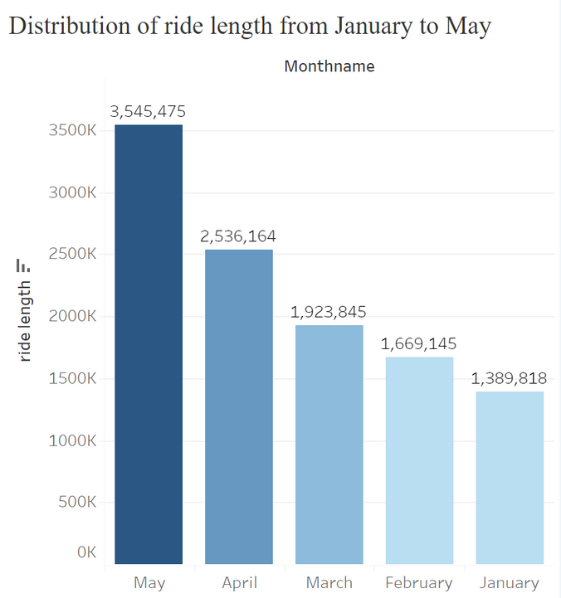
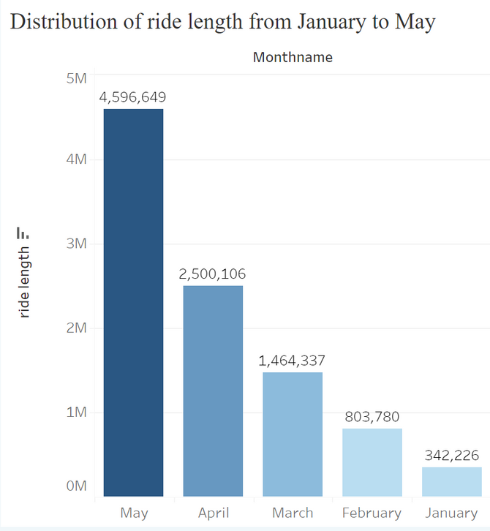
TELL THE STORY (WITH DATA)
Members and casual users spend the most time riding bikes in May.
Even though there are more members than casual users, casual users ride bikes more frequently than members in May.
Member
Casual

Slide 8
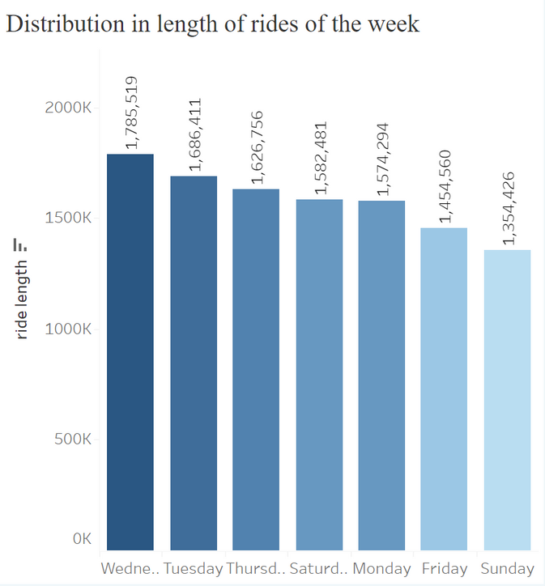
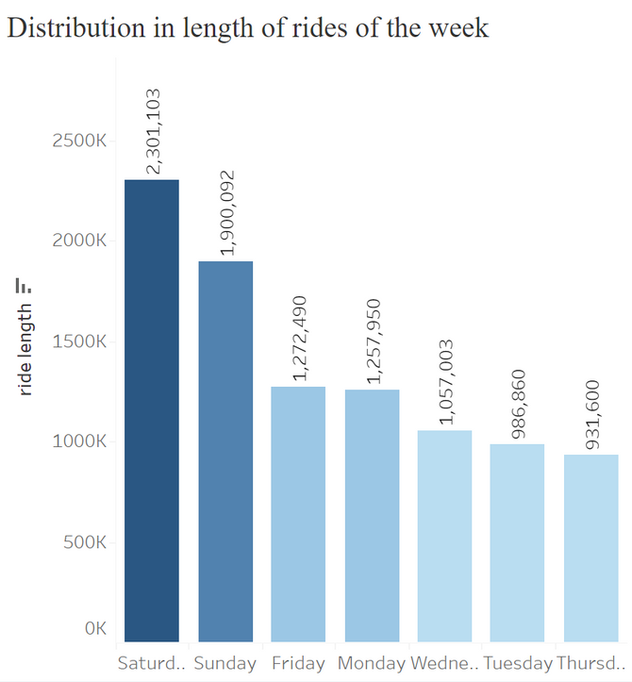
TELL THE STORY (WITH DATA)
Members spend the most time riding bikes during mid-week.
Casual users spend the most time riding bikes during weekends.
Member
Casual

Slide 9
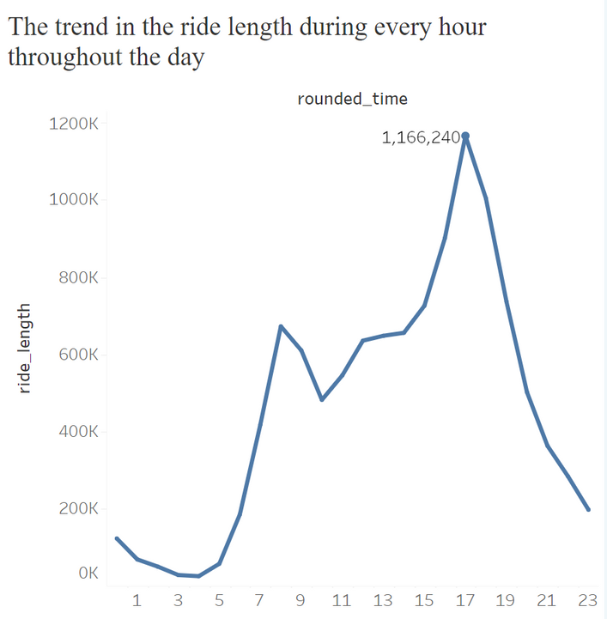
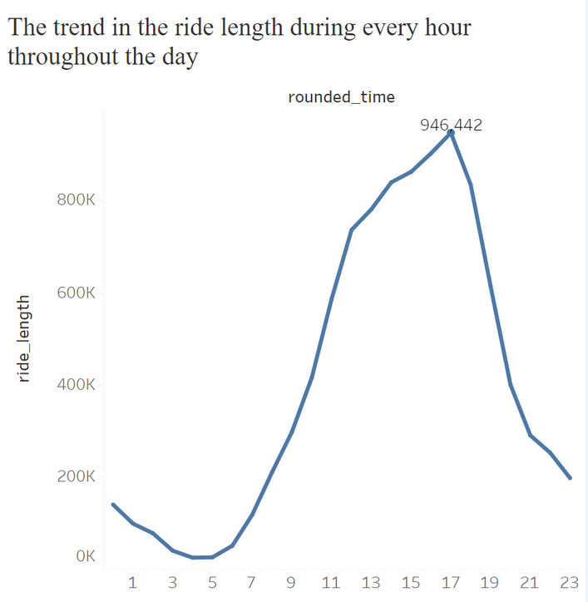
TELL THE STORY (WITH DATA)
The ride length for both members and casual users peaks at 5 PM, reaching 1,166,240, before dropping rapidly and continuing to decrease throughout the night.
Members' ride length sees its second-highest point at 8 AM, with a slight dip followed by a steady climb until 5 PM. In contrast, casual users' ride length consistently increases until it peaks at 5 PM.
Members' ride length begins to rise from 4 AM, while casual users' ride length starts to increase an hour later, at 5 AM.
Member
Casual

Slide 10
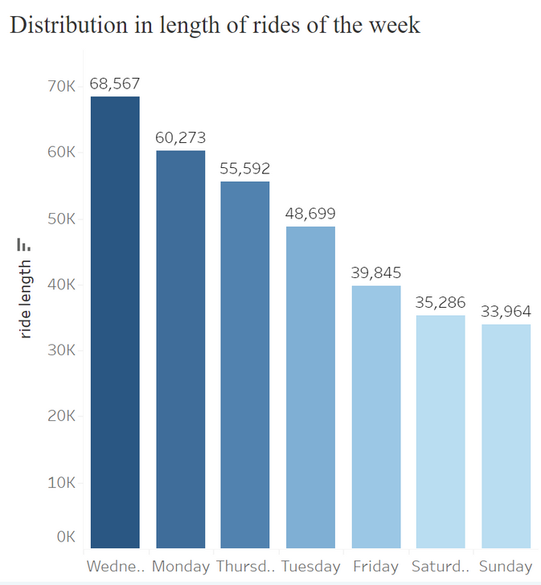
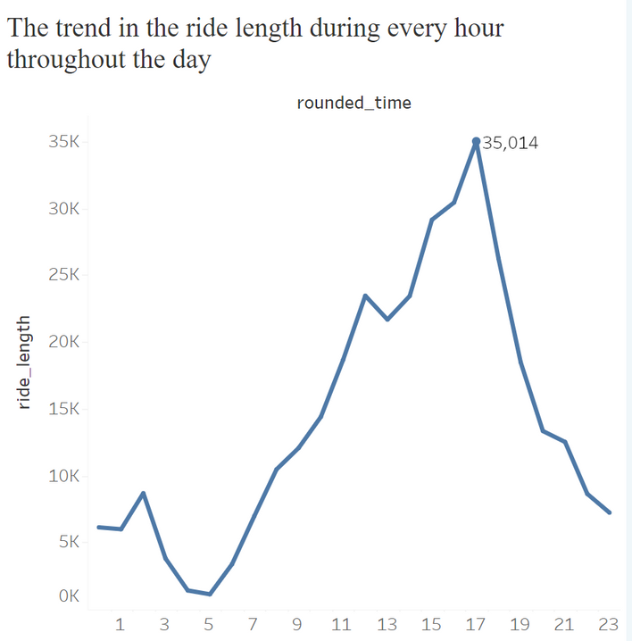
TELL THE STORY (WITH DATA)
For casual users, the data from January stands out compared to other months.
Users spend more time riding bikes on weekdays than on weekends.
Additionally, the ride length shows a slight increase between 1 and 2 AM.
Casual
Casual
Casual

Slide 11
CONCLUSION
Marketing Strategy 1
Marketing Strategy 2
Marketing Strategy 3
Target casual users with personalized emails, ads, and app notifications that emphasize membership benefits during the one-hour window before and after peak times, specifically around 5 PM on weekends in February, March, April, and May.
Shift the budget focus to weekdays in January instead.
Introduce a weekend membership plan with discounts applicable between 5 AM and 5 PM from February to May.
This plan targets casual users who prefer weekend rides but could benefit from the flexibility and savings of a membership.
Promote exclusive benefits for members, such as unlimited electric bike rides, priority access to electric bikes, and discounts on extended rides.

Slide 12
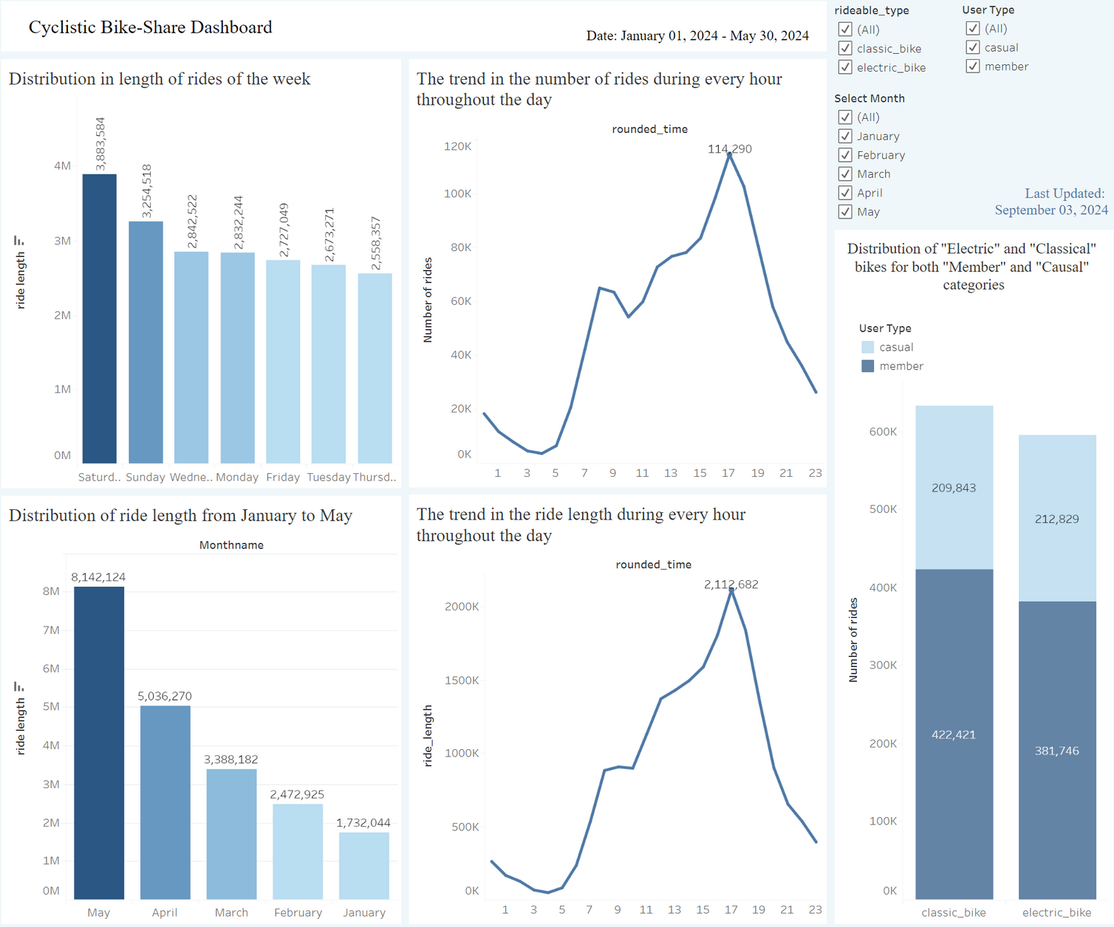
APPENDIX
Link to Tableau Public:
https://public.tableau.com/shared/KGK44CMR7?:display_count=n&:origin=viz_share_link

